Slide 1
New Cooking & Fuel Technologies in Haiti
Rose Bazile, RNC, MSN, RN
Clinical Instructor: Obstetrics and Pediatrics
Adelphi University
Chair of KDCK: www.kdck-cdf.org
Haiti Representative, Solavore LLC: www.solavore.com
Contact: Rosebazile00@gmail.com
rbazile@adelphi.edu

Slide 2
Traditional Cooking Fuel - woods

Slide 3
Charcoal production ruins health and environment

Slide 4
New Cooking & Fuel: Solar Ovens

Slide 5
New Cooking & Fuel: Methane Gas

Slide 6
Partners
Konbit pou Developman Commune Kote de Fer (KDCK)
Solavore LLC
Haiti Adolescent Girls Network
Solar CITIES Biogas Innovators and Practitioners
Persons Helping People
Universite Notre Dame d'Haïti (at Hinche)
Solar Cookers International
ECHO Global Farm
Haiti Education and Resource Team (HEART School)
Public-Private Alliance Foundation (PPAF)

Slide 7
Expected Outcomes
Adoption of new cooking fuel technologies by Haitians will –
empower women and girls,
protect their health and
prevent environmental disasters.

Slide 8
Working with partners
we focus on :
Education
Distribution
Affordability
Empowerment
Partnership
80 Solavore Sport Ovens distributed so far.
Collaboration to build and maintain biodigesters

Slide 9
Konbit pou Developman Commune Kotes de Fer Together for Development of the Commune of Cotes de Fer KDCK is a 501(c)3 charitable organization
KDCK
Persons Helping People

Slide 10
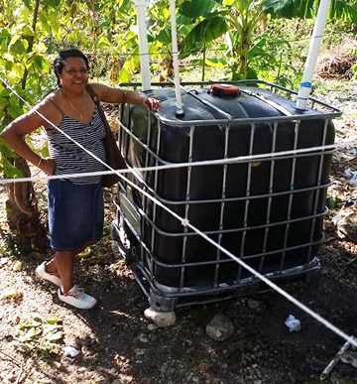
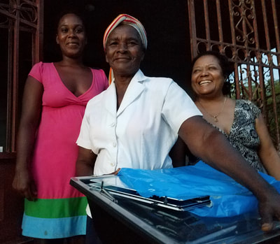
KDCK, PHP and PPAF
Cotes de Fer – solar ovens & biogas
Local demonstrations & sales

Slide 11
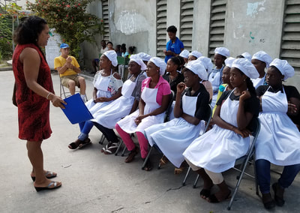
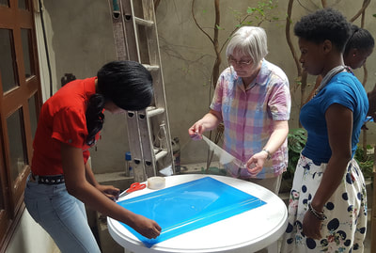
Solavore, PHP & Haiti Adolescent Girls Network
Port-au-Prince – solar ovens
Haiti Adolescent Girls Network – training for entrepreneurship
Local sales initiative through a woman vendor

Slide 12
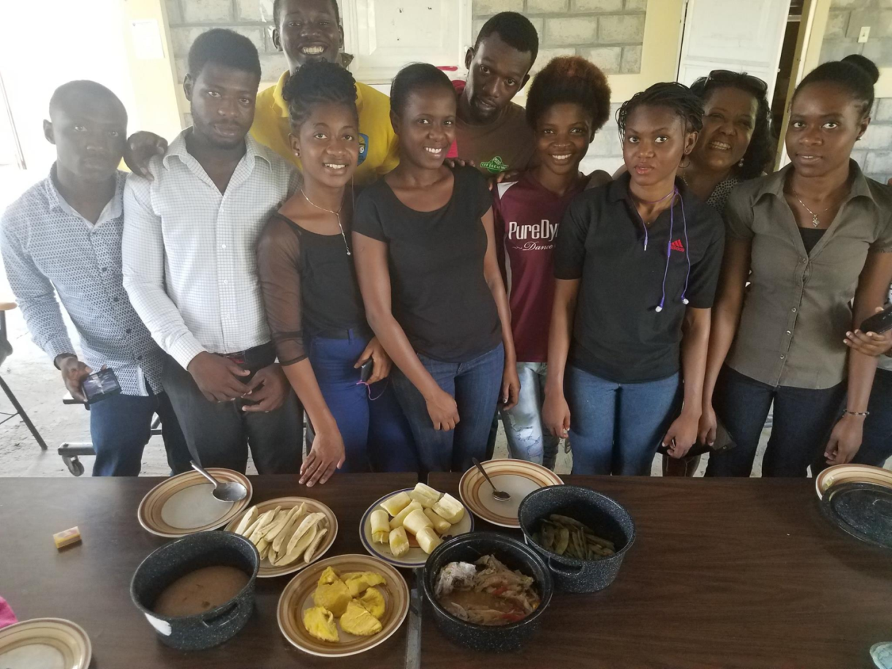
Solavore, PHP, PPAF and UNDH
Hinche - Université Notre Dame– solar & biogas
Vice Rector, students & coordination group are active

Slide 13
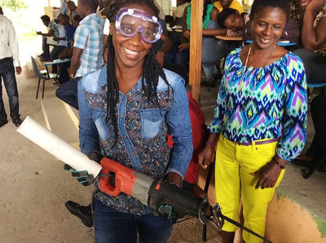
Hinche - Université Notre Dame– Solar Cities
We are working with Solar CITIES, Persons Helping People and PPAF. Solar Cookers International and ECHO Global Farm will be next.

Slide 14
Key elements of success --
Strong community engagement
Solar cooking & biogas in school curriculum
Distribution at affordable price
Women and girls' empowerment

Slide 15
Empowering women and girls through innovations in cooking and fuels

Slide 16
Possibilities @ Université Notre Dame

Slide 17
Solar cooking in progress

Slide 18
Biogas cooking in progress

Slide 19
Senior bioscience student (Peter)

Slide 20
Methane & solar cooked

Slide 21
Nouvo Gaz Commitee

Slide 22
Bioscience students

